Slide 1
Eva Repiso Menendez

Slide 2
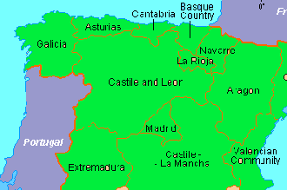
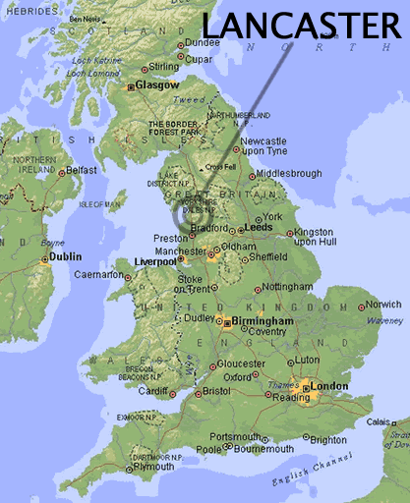
Asturias (Spain)
Lancaster University (UK)

Slide 3
Bsc Physics
Uni. Oviedo (Spain)
Uni. Trieste (Italy)
Msc Renewable Energies
Uni. Autonoma Madrid (Spain)
PhD Physics
Uni. Lancaster
- MBE
GaAs NWs doped with Te
- Crystals of CdZnTe in a Vertical Gradient Freeze furnace

Slide 4
PROMIS WP4: Materials for Enviroment Applications
Project 4.1: Growth and hydrogenation of Sb/N materials for high efficiency mid-IR LEDs in pollutant gas detection
LEDs
Room temperature
λ absorbance gases (CH₄, CO, CO₂, NO…..)

Slide 5
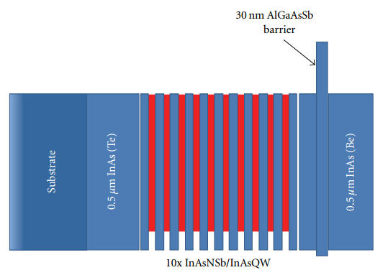
Quantum efficiency
Electron barriers
QW (InAsSb, InAsNSb, hydrogenation, RTA)
QD

Slide 6
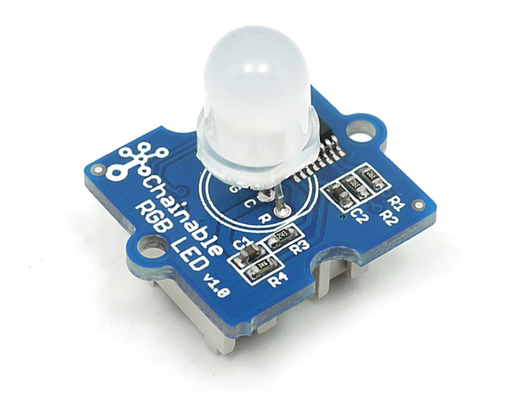
External efficiency
2D hole arrays
Resonant cavity designs

